Slide 1
Cost Estimate of Spam Call Detection Final Presentation Shivam Mishra

Slide 2
Overview
Scope
Ground Rules and Assumptions
WBS
WBS Dictionary
Cost estimate for element 1 of WBS (Data Accumulation)
Cost estimate for element 2 of WBS (ML model development)
Cost estimate for element 3 of WBS (App Update)
Cost estimate for element 4 of WBS (Operation and Maintenance)
Cost estimate for element 5 of WBS (Overhead)
Summary
Risk Analysis

Slide 3
Scope
This cost estimate establishes cost for development, deployment and maintenance of a spam call detection mobile app.
The application integrates machine learning based-solution with black listing mechanism based on users tagging.
This allows the application to block a spam number even if it has not been reported enough.

Slide 4
Ground Rules & Assumptions
The cost estimate for app is only for the iOS platform.
The estimate includes operation and maintenance cost for one year only.
Data collection time is scheduled to be fixed to three months, based on analogy with ref*.
G&A, Project Management and Systems Engineering cost for the project has been estimated as the percentage of the total project cost.
Cost for “promotion” element is not included in this cost estimate.
*ref : A Machine Learning Approach To Prevent Malicious Calls Over Telephony Networks, arXiv:1804.02566v1

Slide 5
WBS
SM Spam Blocker
1. Data Accumulation
2. ML Model Development
3. App Update
4. Operation &
Maintenance
5. Overhead
1.1 Initial App Release
1.2 Database Development
2.1 Training
2.2 Testing
2.3 Parameter Tuning
3.1 App & ML model Integration
3.2 Testing
3.3 Update Roll Out
4.1 App Operations & Maintenance
4.2 Database update & Maintenance
4.3 ML model Update & Maintenance
5.1 Hardware
5.2 Cloud Services
5.3 Systems Engineering
5.4 Project Management
5.5 G&A

Slide 6
WBS 1.Data Accumulation
1.1 Initial App Release
1.1.1 Design
1.1.2 Development
1.1.3 Testing
1.1.4 Deployment
1.1.2.1 Front-end development
1.1.2.2 Back-end Development
1.1.2.3 Integration
1.1.4.1 Beta Release
1.1.3.1 Unit
1.1.3.2 Integration
1.1.3.3 System
1.1.3.4 Acceptance
1.1.4.2 Promotion
1.1.4.3 Stable Release

Slide 7
WBS 1. Data Accumulation
1.2 Database Development
1.2.1 Data Collection from app
1.1.2 Data Cleaning
1.1.3 Feature Engineering
1.1.4 Data Pre-Processing

Slide 8
WBS Dictionary
Front-end Development | Development of Graphical interface for the application.
Back- end Development | Development of data-access layer for the application.
Integration | Integrating of front and back end part of the application.
Unit Testing | Test to check the functioning of individual components of the software.
Integration Testing | Test to verify the interfaces between components against a software design.
System Testing | System testing tests a completely integrated system to verify that the system meets its requirements.
Acceptance Testing | Test to check operational readiness of the application.
Beta Release | Release of the beta version of the app, released to limited users to acquire feedback on the application.
Promotion | Promotion of the application, constitutes ads on the app store and other promotion strategy.
Stable Release | Release of the final version of the application.
Training | Training the machine learning model on training dataset.
Testing | Testing performance of the models on testing dataset.
Parameter Tuning | Tune hyper parameters of the models for better accuracy.
Hardware | Hardware requirements for the project, mainly includes computer systems required.

Slide 9
WBS Dictionary (Contd.)
Cloud Services | Services made available through cloud computing provider’s server.
G&A | General and Administrative costs
Data Cleaning | Removing redundant, incomplete data points from the data-set.
Data Pre-processing | Processing data to the required format so as to fed to the ML pipeline.
Feature Engineering | Create additional features based of existing features

Slide 10
1.1 Initial App Release
1.1 Initial App Release
 | Median Low (Hours) | Median High (Hours)
1.1.1 Design | 52.125 | 238.5
1.1.2 Development | 165.5 | 733.5
1.1.3 Testing | 30 | 160
1.1.4 Deployment | 5.125 | 11
Total Hours | 252.75 | 1143
Source : Clutch App Development Survey
Average hours required for 1.1 = (252.75 + 1143)/2 = 697.75 hours ~ 700 hours

Slide 11
1. Initial App Release (Contd.)

Slide 12
1. Initial App Release (Contd.)

Slide 13
How long does it takes to make a clone of some of the famous mobile applications? *
* Contains a summary of application’s basic features and their development time.
Source : Codemntr.io/app-costs

Slide 14
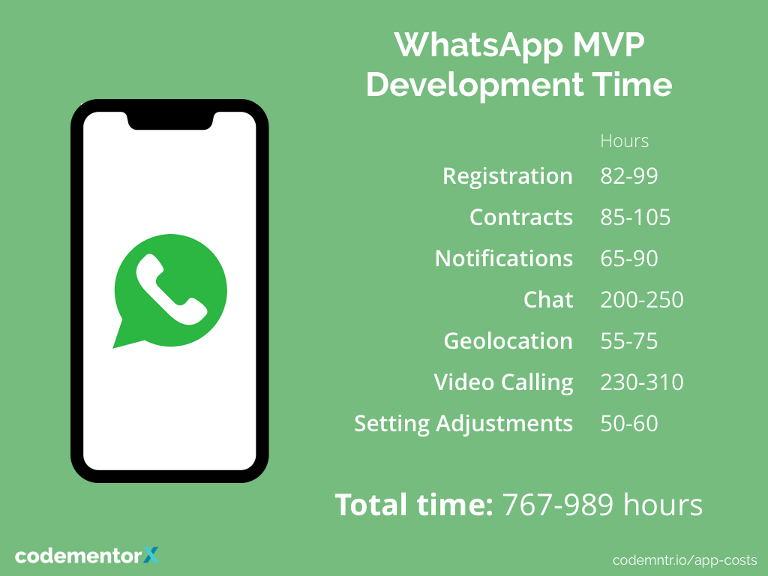
Sources : Django Stars and TheAppSolutions

Slide 15
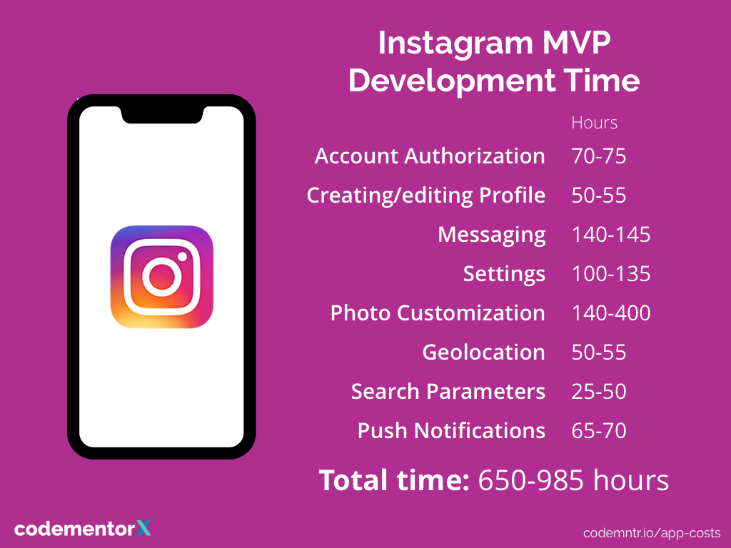
Sources : CleverRoad and SteelKiwi

Slide 16
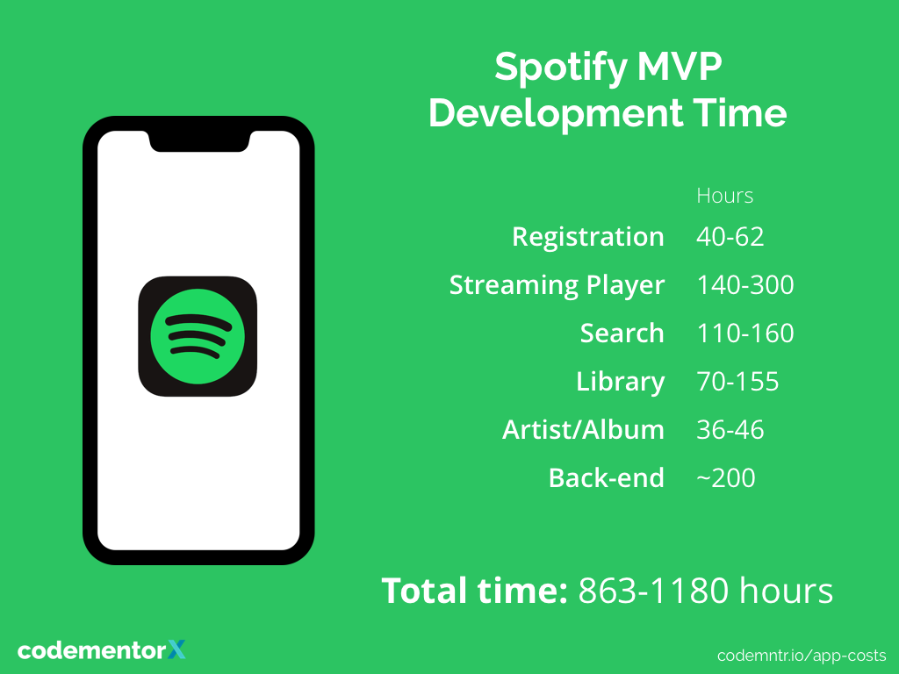
Sources: thinkmobiles, Appinventiv, idapgroup

Slide 17
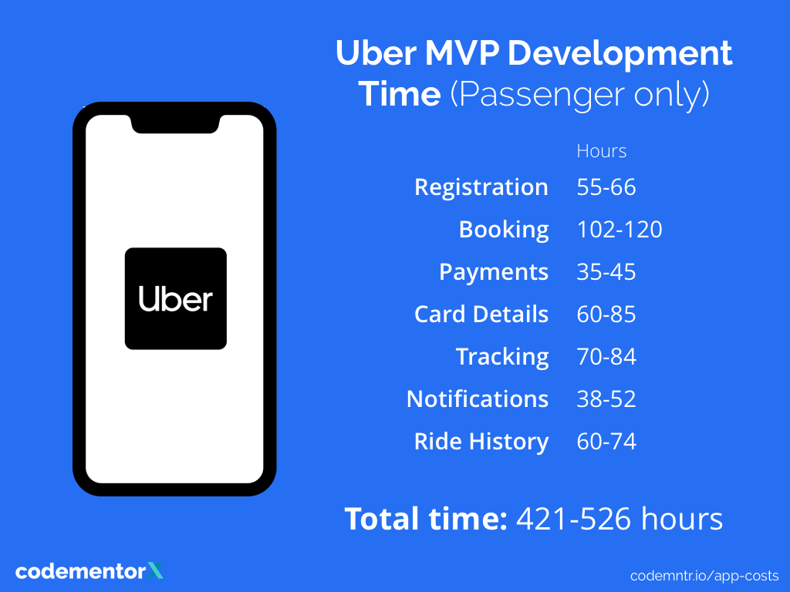
Sources : codementor

Slide 18
Pay for iOS developers in USA
Source | Minimum Salary (annual) | Average Salary (annual) | Maximum Salary (annual)
Glassdoor | 16000 | 102000 | 113000
Zip Recruiter | 24000 | 84000 | 133000
Indeed | 42000 | 124000 | 140000
PayScale | 58000 | 84000 | 125000
Average | 35000 | 98500 | 127750

Slide 19
Summary 1.1 Initial App Release
Average Hours for Initial Application development = 700 hours
Average salary for iOS developers = $ 98500/ year = $98500 / 1920 hours = $ 51.30 / hour *
Average cost for Initial App Release = $ 51.30 / hour * 700 hours = $ 35, 910
* assuming 5 day work week, 8 hours work duration per day and 15 days of other leaves.

Slide 20
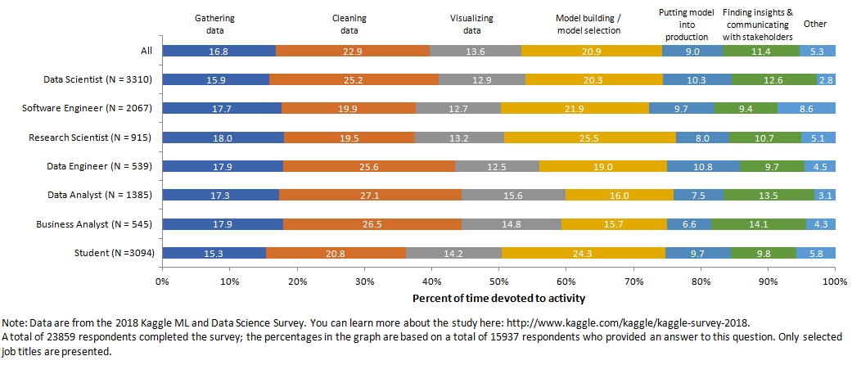
Proportion of time devoted to different Machine Learning tasks.

Slide 21
The time required for data accumulation is taken to be three months, based on the analogy with the similar project where machine learning was used to classify the benign and spam calls in China. (see next slide)
The time required for other parameters can be calculated based on the Kaggle survey reference where around 24 thousand professionals have weighted (as percentage of the total project time, see previous slide) the time devoted to specific machine learning tasks.
The weight for different tasks is summarized below.
As the time required for the data collection task is fixed at 3 months. The time for others can be calculated by unitary method.
Since most of the other task are a function of the data collected initially, this unitary method can give a good approximation for the time spent on each of the task.
Tasks | Weights
Data collection | 0.168
Data Cleaning | 0.229
Data Preprocessing and Feature Engineering | 0.136
Model development | 0.209
ML model and app integration | 0.09
Others | 0.168

Slide 22
1.2 Database Development
Data used for training ML model to identify malicious calls in China. Collected through similar tagging by users (using TouchPal application) methods in a time period of 3 months.
For this project, it is intended to gather data for the same time period as in the reference above. The data collected in this period can be less than the reference example. But, as the number of smart-phone users in USA is approximately one third of the number of smartphone users in China*, it is assumed that the collected data would be able to capture all the necessary variations important for classifying malicious and benign calls in the same time period.
Benign Calls | 8929 millions
Malicious Calls | 73 millions
Total Calls | 9002 millions
Reference : A Machine Learning Approach To Prevent Malicious Calls Over Telephony Networks (arXiv:1804.02566v1)
*Reference : Top countries by smartphone penetration and users - Newzoo

Slide 23
1.2 Database Development (Contd.)
Time devoted to data collection is 3 months (decided based on analogy). The table and pie chart below shows the time required for data cleaning, feature engineering and data preprocessing (tasks listed under 1.1.2 ) calculated based on the 2018 Kaggle and Data Science Survey.
 | Task | Weight* | Calculation | Hours
1.2.1 | Data Collection | 0.168 | 0.168*(720/0.168) | 720 hours
1.2.2 | Data Cleaning | 0.229 | 0.229*(720/0.168) | 981 hours
1.2.3 | Feature Engineering | 0.136 | 0.136*(720/0.168) | 583 hours
1.2.4 | Data Pre processing

Slide 24
1.2 Database Development (Contd.)
Pay for Machine Learning Engineers in USA
Source | Minimum Salary (annual) | Average Salary (annual) | Maximum Salary (annual)
Glassdoor | 87000 | 121000 | 158000
Indeed | 51000 | 135000 | 259000
PayScale | 78000 | 112000 | 161000
Average | 72000 | 123000 | 193000
Average salary for Machine Learning Engineer = $ 123000 / year = $ 123000 / 1920 hours = $64 / hour
* assuming 5 day work week, 8 hours work duration per day and 15 days of other leaves

Slide 25
1.2 Database Development (Contd.)
 | Task | Hours | Calculation | Amount in $
1.2.1 | Data Collection | 720 | 720*64 | 46080
1.2.2 | Data Cleaning | 981 | 981*64 | 62784
1.2.3 | Feature Engineering | 583 | 583*64 | 37312
1.2.4 | Data Pre processing
Total |  | 2284 |  | 146176

Slide 26
1.2 Database Development (Contd.)

Slide 27
1. Data Accumulation
1.1 Initial App Release | $ 35910
1.2 Database Development | $146176
Total | $182,086

Slide 28
2 ML Model Development
In general, machine learning projects take up to 80 % of the task for dataset development and 20 % of the time for model development or model building. For this project, time required for model development is calculated using the Kaggle survey data. The Kaggle survey reveals an average ratio of 2.55 (0.533/0.209) between the time required for database development and the time required for the model development.
The time calculated for the database development is 2284 hours. Using the above ratio, the time required for model development of this project = (2284/2.55) = 895.68 hours ~ 900 hours.
Cost for the ML model development, considering model development time of 900 hours and $64 as the hourly rate of the Machine Learning Engineer = ($ 64 /hour) * (900) = $ 57,600
 | Task | Weight | Calculation | Time (hours) | Calculation | Cost (in USD)
2 | ML model development | 0.209 | 0.209*(720/.168) | 900 | 900*64 | 57600

Slide 29
3 Application Update
3.1 App and ML model Integration
The time required for the application and ML model integration is calculated using the weight derived using kaggle survey data. The calculation is summarized in the table below.
The Kaggle survey reveals an average ratio of 1.867 (0.168/0.09) between the time required for data collection and the time required for application and model integration (putting model into production).
The time calculated for the database development is 720 hours. Using the above ratio, the time required for app and ML model integration for this project = (720/1.867) = 385 hours
Cost for the app and ML model integration, considering time required be equal to 385 hours and $64 as the hourly rate of the Machine Learning Engineer = ($ 64 /hour) * (385) = $ 24,640
 | Task | Weight | Calculation | Time (hours) | Calculation | Cost (in USD)
3.1 | App and ML model integration | 0.09 | 0.09*(720/.168) | 385 | 385*64 | 24640

Slide 30
3 Application Update (Contd.)
3.2 Testing & 3.3 Update Roll Out
The time required for testing and update roll out after the ML model and app integration is calculated using the Clutch Survey Data, presented before.
The median high and median low hours required for the testing and update roll out is taken to be the same as the time taken for application testing and application deployment. The survey results for the selected part are summarized in the table below.
The cost for testing and update roll out is calculated by multiplying the hours required for the project with the hourly rate of the iOS developers ( $ 51.30 per hour ). The calculation for the same is summarized in the table below.
 | Median Low (Hours) | Median High (Hours) | Average (Hours)
3.2 Testing | 30 | 160 | 95
3.3 Update Roll Out | 5.125 | 11 | 8.0625
Task | Average hours | Calculation | Cost (USD)
3.2 Testing | 95 | 95*51.3 | 4873.5
3.3 Update Roll Out | 8.0625 | 8.0625*51.3 | 413.6

Slide 31
3 Application Update (Contd.)
Summary
Task | Average hours | Calculation | Cost (USD)
3.1 App and ML model Integration | 385 | 385*64 | 24640
3.2 Testing | 95 | 95*51.3 | 4873.5
3.3 Update Roll Out | 8.0625 | 8.0625*51.3 | 413.6
TOTAL |  |  | 251687.1

Slide 32
4 Operations and Maintenance
Application operations and maintenance engineer salary in USA.
Source | Low (annual) | Mean (annual) | High (annual)
Glassdoor | $ 64000 | $ 89000 | $ 161000
Indeed | $ 25000 | $ 78000 | $ 108000
Payscale | $ 49000 | $ 69000 | $ 97000
ZipRecruiter | $ 45000 | $ 90000 | $ 117000
Average | $ 45750 | $ 81500 | $ 120750
Database administrator salary in USA.
Source | Low (annual) | Mean (annual) | High (annual)
Glassdoor | $ 65000 | $ 87000 | $ 118000
Indeed | $ 32000 | $ 93000 | $ 184000
Payscale | $ 46000 | $ 73000 | $ 110000
ZipRecruiter | $ 52000 | $ 101810 | $ 145500
Average | $ 48750 | $ 88700 | $ 139250

Slide 33
4 Operations and Maintenance (Contd.)
The operations and maintenance cost is divided into three parts, app operations and maintenance cost, database update and maintenance cost and ML model update and maintenance cost.
The number of people in a scrum team is summarized in the table below*.
The structure is decided on the consultation with my advisor, Nilanjana Ghosh who has worked in the IT industry for three years and based on the assumption that [4] would follow agile methodology. The structure can vary based on the complexity of the application. The team structure along with cost to each parts for the Operations and Maintenance is described in the table below:
Source | People in Scrum team
M. Cohn, "Team Structure," in Succeeding with Agile: Software Development Using Scrum, Addison-Wesley Professional, 2009, pp. 177-199. | 5-9
J. Sutherland, The scrum papers: Nuts, bolts, and origins of an agile process, Cambridge: scruminc.com, 2012. | 7
Practical Scrum-Scrum Team: Way to Produce Successful and Quality Software, 2013 13th International Conference on Computational Science and Its Applications. | 3-9
* assuming that the (4) would follow agile methodology
 | Team | Number of members | Average salary (annual) | Calculation | Total Cost
4.1 | App operations and maintenance team | 5 | $ 81500 | 5* 81500 | $ 407500
4.2 | Database update and maintenance team | 3 | $ 88700 | 3* 88700 | $ 266100
4.3 | ML model update and maintenance team | 3 | $ 98500 | 3* 98500 | $ 295500

Slide 34
4 Operations and Maintenance (Contd.)
Summary
 | Team | Number of members | Average salary (annual) | Calculation | Total Cost
4.1 | App operations and maintenance team | 5 | $ 81500 | 5* 81500 | $ 407500
4.2 | Database update and maintenance team | 3 | $ 88700 | 3* 88700 | $ 266100
4.3 | ML model update and maintenance team | 3 | $ 98500 | 3* 98500 | $ 295500
TOTAL |  |  |  |  | $ 969100

Slide 35
5 Overhead
5.1 Hardware.
The hardw5.2 Cloud Services.
are cost is the cost of the laptops purchased for the project. The estimation for the laptops required for the project is capped at thirty. Hardware cost is calculated below. The cost for each laptop is extracted from vendor quotes (amazon, BestBuy).
Cost = 30 * $ 1300 = $ 39000 ~ $ 40000
5.2 Cloud Services.
The cloud requirement for the project is estimated to be 50TB. The rate for standard storage on Google Cloud is $0.026 per GB per month. Following the google cloud rate, the cloud services cost for 50TB storage for one year is calculated below.
Cost = (50 * 1024 GB)*($ 0.026/month * GB)*(12 month) = $ 15975
5.3 Systems Engineering
The systems Engineering cost for the project is taken as to be the 15 percent of the project cost (industry average). The cost for the same is calculated below.
Cost = 0.15 * ( 251687.1 + 57600 + 182086 + 969100) = 0.15 * (1460473.1) = $ 219070

Slide 36
5 Overhead (Contd.)
5.4 Project Management
The project management cost for the project is taken to be the 8 percent of the project cost*. Same is calculated below.
Cost = 0.08 * $ 1460473.1 = $ 116838
*ref : Byrne, J. P. (1999). Project management: how much is enough?
5.5 General and Administrative Cost
The G&A cost for the project is taken to be the 10 percent of the project cost*. Same is calculated below.
Cost = 0.10 * $ 1460473.1 = $ 146047.31
*nationalservice.gov
Notes:
ref : Byrne, J. P. (1999). Project management: how much is enough?
ref : Byrne, J. P. (1999). Project management: how much is enough?

Slide 37
5 Overhead (Contd.)
Summary
 | Cost (USD)
5.1 Hardware | 40000
5.2 Cloud Services | 15975
5.3 Systems Engineering | 219070
5.4 Project Management | 116838
5.5 G&A | 146047
Total | 537930
Notes:
ref : Byrne, J. P. (1999). Project management: how much is enough?
ref : Byrne, J. P. (1999). Project management: how much is enough?

Slide 38
Summary Slide
 | Cost (USD)
1. Data Accumulation | 182086
2. ML model development | 57600
3. App Update | 251687
4. Operation and Maintenance | 969100
5. Overhead | 537930
TOTAL | 1998403
Top down Estimate presented in kick off presentation = $ 2.25 Million
Bottoms up cost estimate = $ 1998403 ~ $ 2 Million

Slide 39
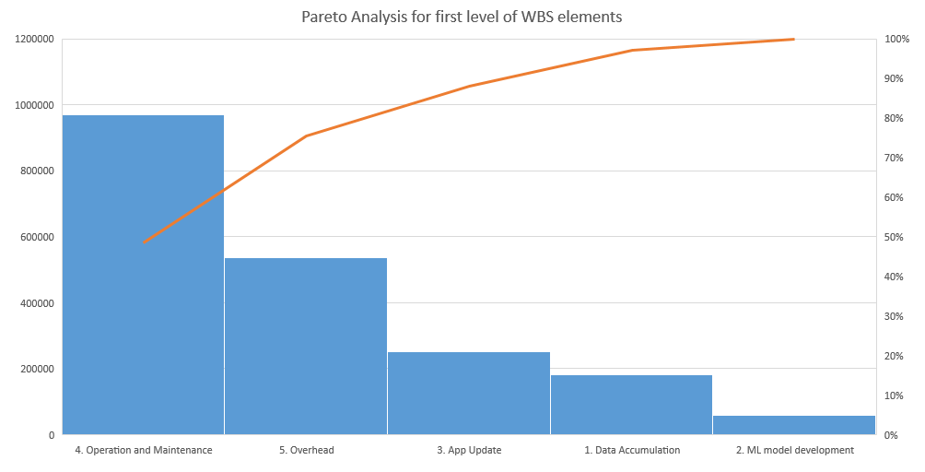
Summary Slide (Contd.)

Slide 40
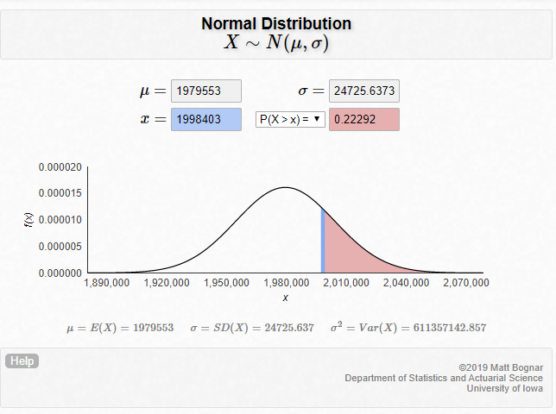
Risk Analysis
The risk of cost overrun for the estimated cost of $1998403 is 22.3%.
The risk is calculated considering different values for element 4, as it is the largest cost driver.

